Slide 1

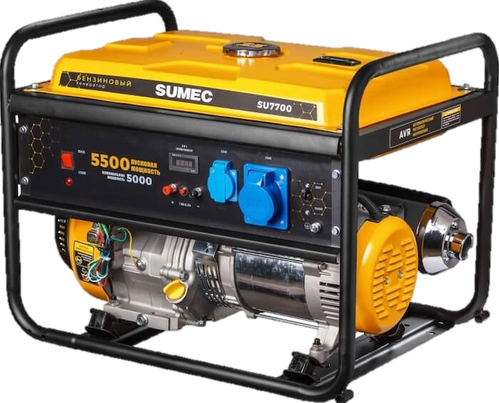
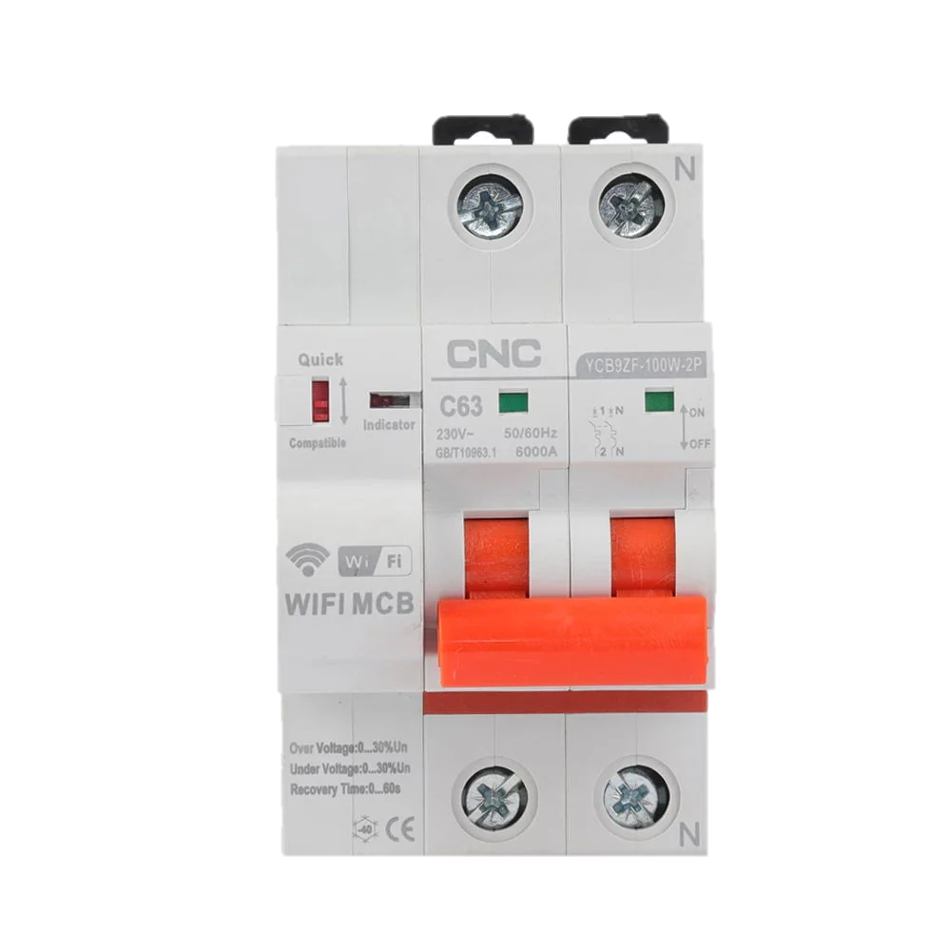
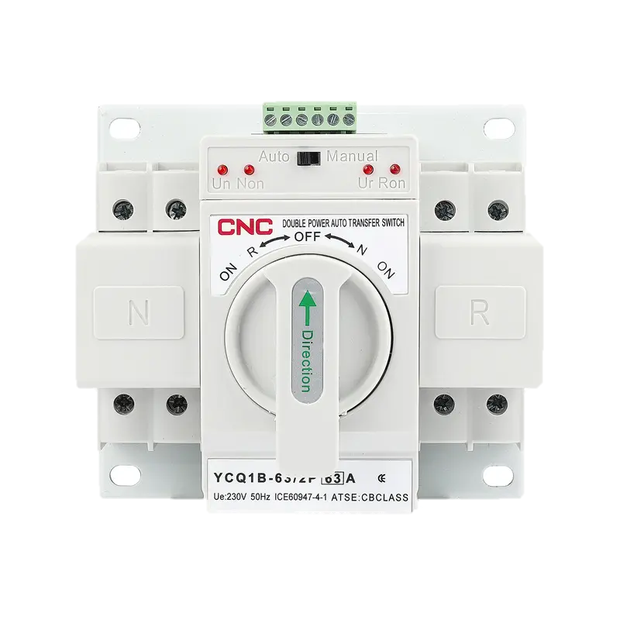
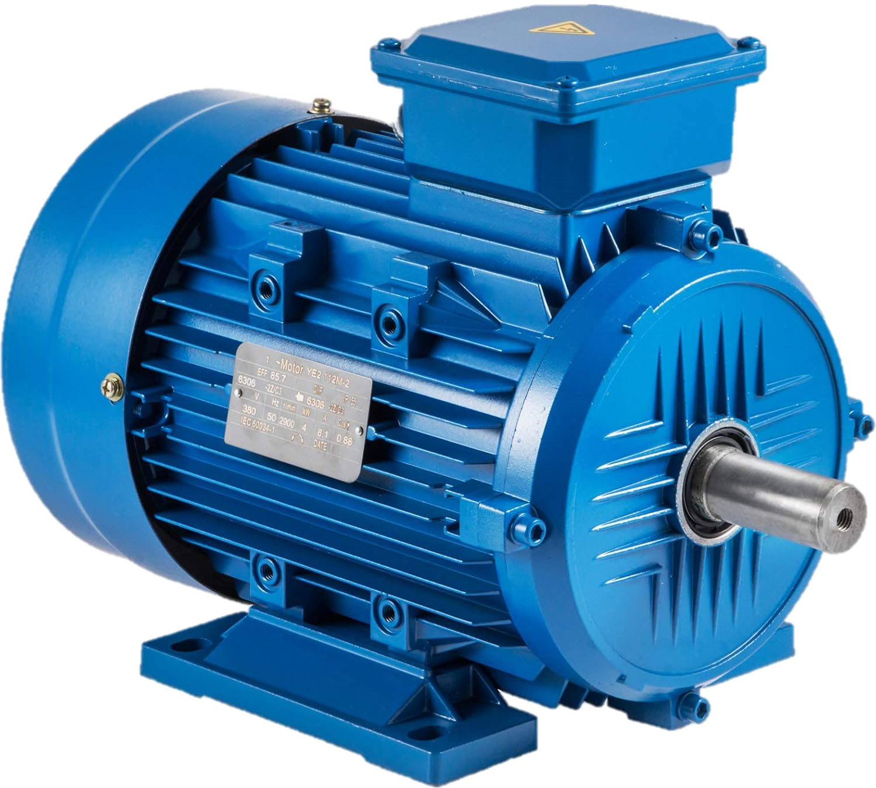
City
Main power supply
Household
Generator
Automatic Transmission
Switch
Load

Slide 2
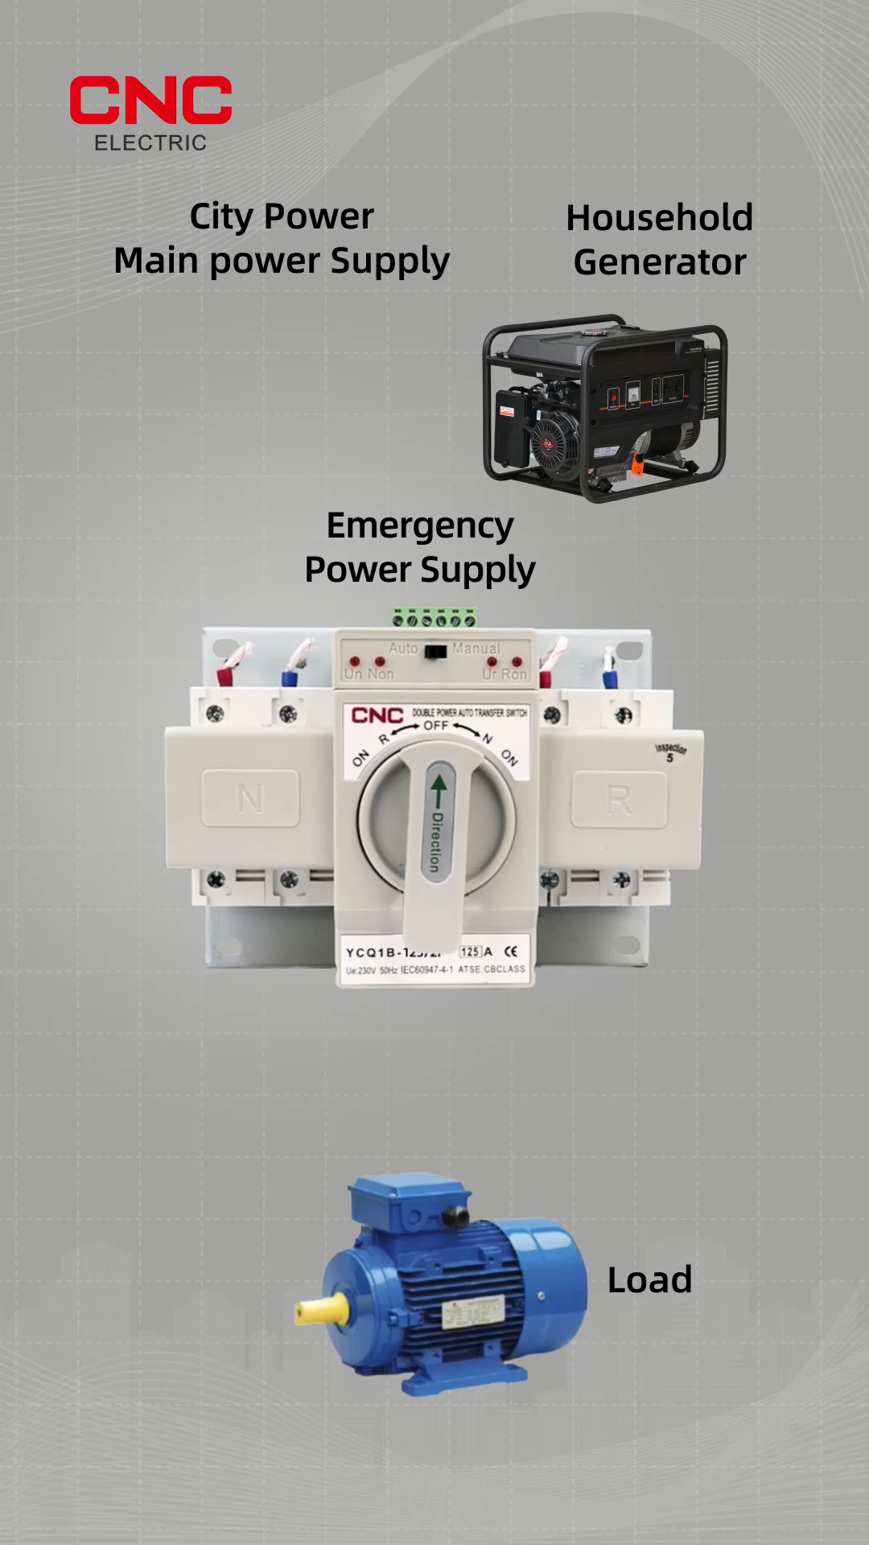
City
Main power supply
Household
Generator
Automatic Transmission
Switch
Load

Slide 3
City
Main power supply
Household
Generator
Automatic Transmission
Switch
Load

Slide 4
City
Main power supply
DUAL
POWER
Household
Generator
Automatic Transmission
Switch
Load
Automatic Transfer Switch

